Slide 1

COST
Probability and Random Variables

Slide 2
Question
A box contains 6 white and 4 black balls. 2 balls are selected at random from the box one after another. Find the probability that both balls are white if the balls are selected
Without replacement
With replacement
W - 6
B - 4
W1 = event of drawing 1st white ball
W2 = event of drawing 2nd white ball

Slide 3


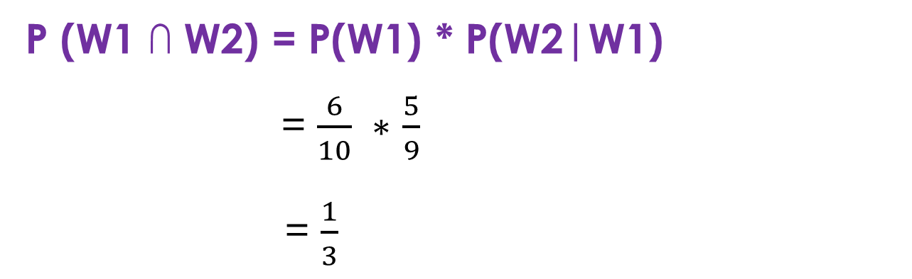
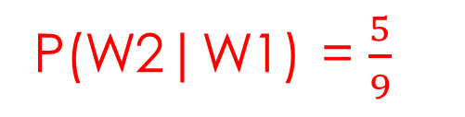
Cont.…
Without Replacement- $Dependent events$
W - 6
B – 4
Total = 10
1st ball drawn is white
W1
W - 5
B – 4
Total = 9
2nd ball drawn is white
W2
P(W2|W1) = $\frac{5}{9}$
P(W1) = $\frac{6}{10}$
P (W1 ∩ W2) = P(W1) * P(W2|W1)
= $\frac{6}{10} ∗$ $\frac{5}{9}$
= $\frac{1}{3}$

Slide 4


Cont..
With replacement- Independent Events
W - 6
B – 4
Total = 10
1st ball drawn is white
W1
W - 6
B – 4
Total = 10
2nd ball drawn is white
W2
P(W1) = $\frac{6}{10}$
P(W2) = $\frac{6}{10}$
P (W1 ∩ W2) = P(W1) * P(W2)
= $\frac{6}{10} ∗$ $\frac{6}{10}$
= $\frac{9}{25}$

Slide 5
Practice Question
A box contains 9 tickets numbered from 1 to 9 inclusive. If 3 tickets are drawn from the box one at a time, find the probability that they are alternately either-
(1) odd, even, odd
(2) even, odd, even.

Slide 6
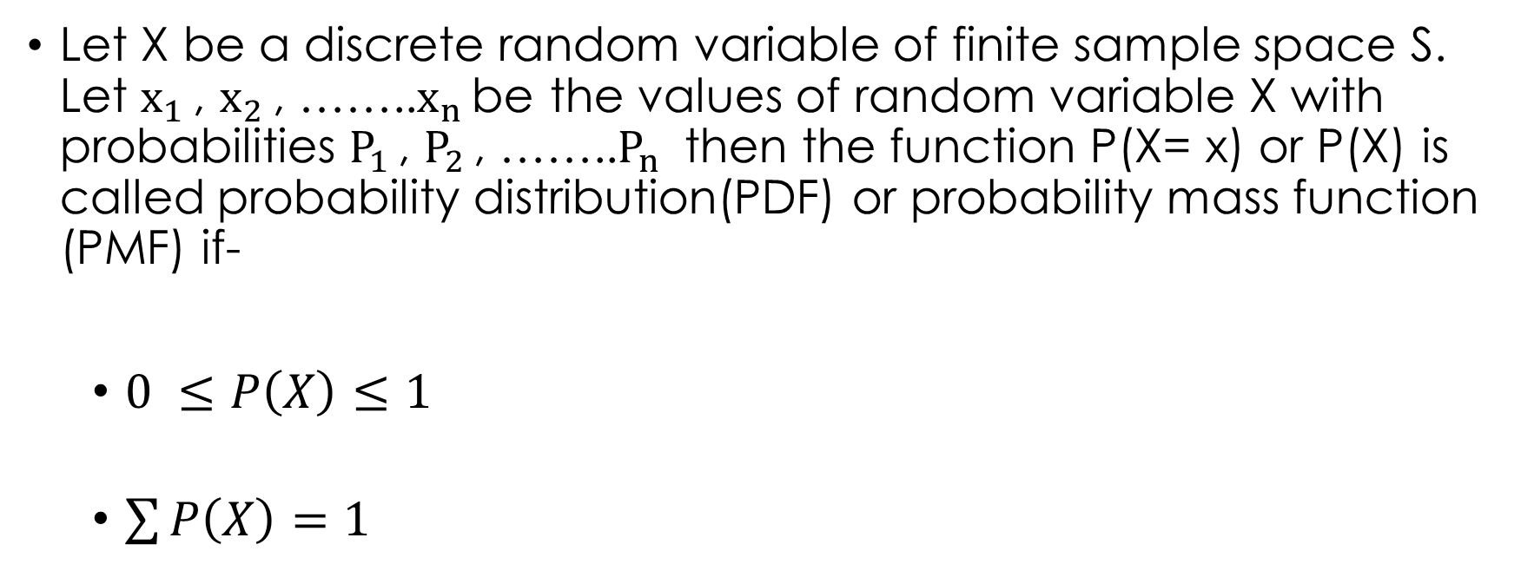
Random Variable
Let X be a discrete random variable of finite sample space S. Let $x_{1 }$, $x_{2 }$, ……..$x_{n }$be the values of random variable X with probabilities $P_{1 }$, $P_{2 }$, ……..$P_{n }$ then the function P(X= x) or P(X) is called probability distribution(PDF) or probability mass function (PMF) if-
$0 ≤P\left(X\right)≤1$
$\sum{P\left(X\right)}=1$

Slide 7
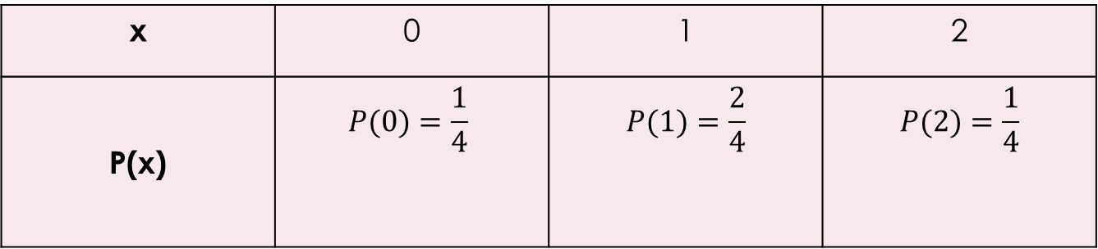
Example
Random experiment- 2 coins are tossed
Let random variable X – no of Heads
S= {HH , TH, HT, TT}
x- 0, 1, 2
Probability Distribution of X-
x | 0 | 1 | 2
P(x) | $$P(0)=\frac{1}{4}$$ | $$P(1)=\frac{2}{4}$$ | $$P(2)=\frac{1}{4}$$

Slide 8

Expected value E(x) and Variance V(x)
Mean of X – E(X)
$$E\left(X\right)= \sum{x P\left(x\right)}$$
Variance of X – V(X)
$$V\left(X\right)= σ^{2}=E \left(X^{2}\right)−{[E(X)]}^{2}$$
Where, $E \left(X^{2}\right)$ = $\sum{x^{2} P\left(x\right)}$

Slide 9
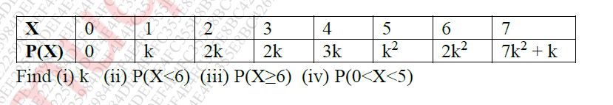
MU Nov18
A random variable X has the following probability distribution values of X

Slide 10


Solution-
$$\sum{P\left(X\right)}=1$$
0 + k + 2k + 2K + 3k + $k^{2}+$ ${2k}^{2}+{(7k}^{2}+k$) = 1
9k + 10 $k^{2}=1$
$${10k}^{2}+9k −1=0$$
$${10k}^{2}+10k −k −1=0$$
$$10k\left(k+1\right)−\left(k+1\right)=0$$
$$(10k−1)\left(k+1\right)=0$$
k = $\frac{1}{10 } or k$ = -1
Probability cannot be negative
Hence, k= $\frac{1}{10 }$= 0.1

Slide 11

Solution-
$P(X<6)$ = P(0) + P(1) + P(2) + P(3) + P(4) + P(5)
= $k^{2}+8k$
= 0.81
$P(X≥6)$ = P(6) + p(7)
= ${9k}^{2}+k$
= 0.19
$P\left(0<X<5\right)=P\left(1\right)+P\left(2\right)+P\left(3\right)+P\left(4\right)$
= 8k
=0.8

Slide 12

Practice Question
Find P(8<X<20), P(X >=20) , E(X), $E \left(X^{2}\right)$, V(X) and std. deviation for the probability distribution given below.
X | 8 | 12 | 16 | 20 | 24
P(X) | 1/8 | 1/6 | 3/8 | 1/4 | 1/12

Slide 13
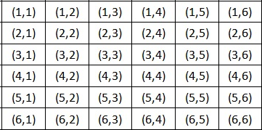
April 2019
A pair of fair dice is tossed and let X denote the sum of the points obtained. Find probability Distribution of X. Also find Expectation of X.
S =
X = {2, 3, 4, 5, 6, 7, 8, 9, 10, 11, 12}

Slide 14
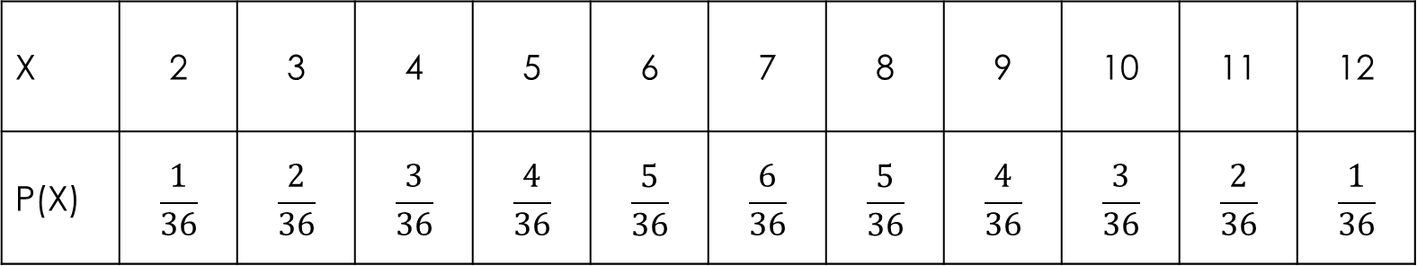

Cont..
PDF
E(X) = $\sum{x P\left(x\right)}$ =
X | 2 | 3 | 4 | 5 | 6 | 7 | 8 | 9 | 10 | 11 | 12
P(X) | $$\frac{1}{36}$$ | $$\frac{2}{36}$$ | $$\frac{3}{36}$$ | $$\frac{4}{36}$$ | $$\frac{5}{36}$$ | $$\frac{6}{36}$$ | $$\frac{5}{36}$$ | $$\frac{4}{36}$$ | $$\frac{3}{36}$$ | $$\frac{2}{36}$$ | $$\frac{1}{36}$$

Slide 15
Question
Three marbles are drawn without replacement from an urn containing 4 red and 6 white marbles. If X is a random variable that denotes the total number of red marbles drawn, (a) construct a table showing the probability distribution of X (b) Also find expected value of X.

